Slide 1
Lesson objective
Title: Best buy
Aim:
Compare items using the unitary method
State the probability of single events
Plan:
Review probability
Unitary method best buys

Slide 2
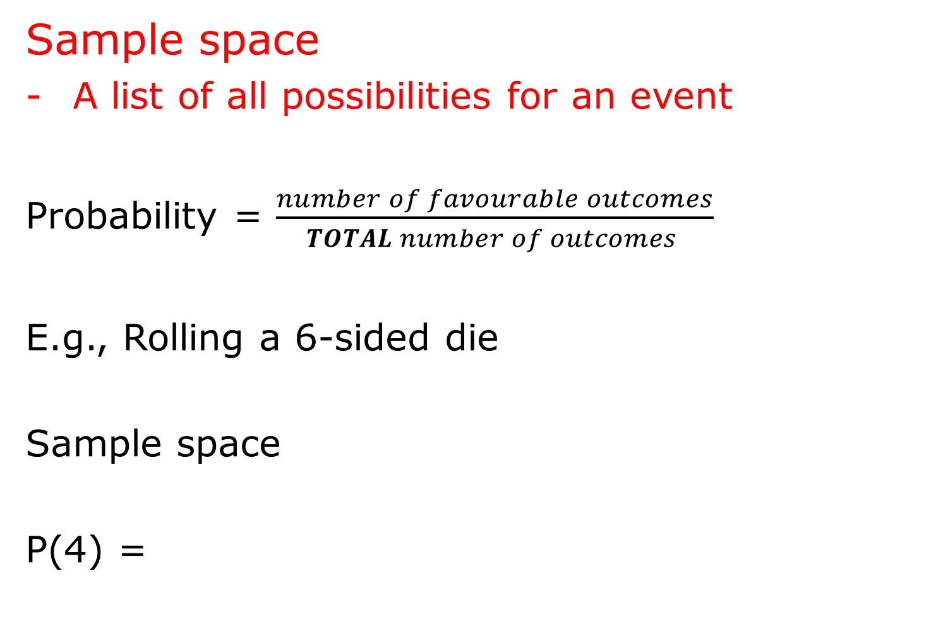
Sample space
A list of all possibilities for an event
Probability = $\frac{number of favourable outcomes}{TOTAL number of outcomes }$
E.g., Rolling a 6-sided die
Sample space
P(4) =

Slide 3

Sample space
A list of all possibilities for an event
Probability = $\frac{number of favourable outcomes}{TOTAL number of outcomes }$

Slide 4
Letters from the word FISHING are put on cards and shuffled.
Sample space
Drawing the letter I

Slide 5
A bag has 4 marbles in it, 1 red, 1 yellow, 1 green and 1 blue.
What is the sample space?
Probability of pulling out a red?

Slide 6
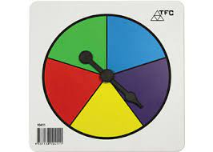
Write into exercise bools
What is the sample space?
What is the P(green)
What is the Probability of not getting green?

Slide 7
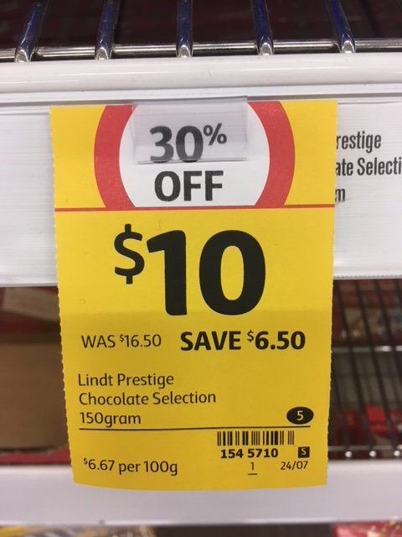
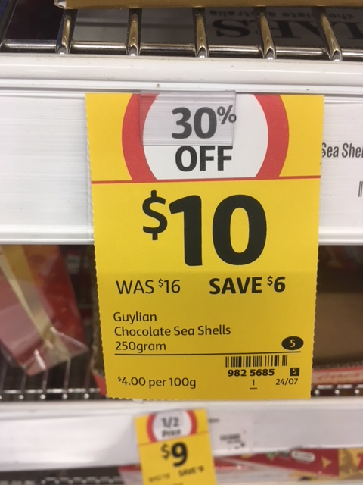
What does ‘Best buy’ mean?
Compare different products on their value for money
Get more product for the same price
Pay less for the same amount of product
‘per’ means ‘for every’

Slide 8
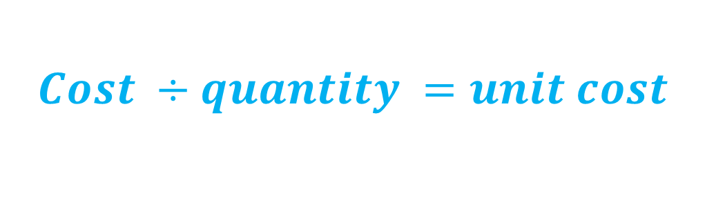
Quick Best Buys
$$Cost ÷quantity =unit cost$$

Slide 9
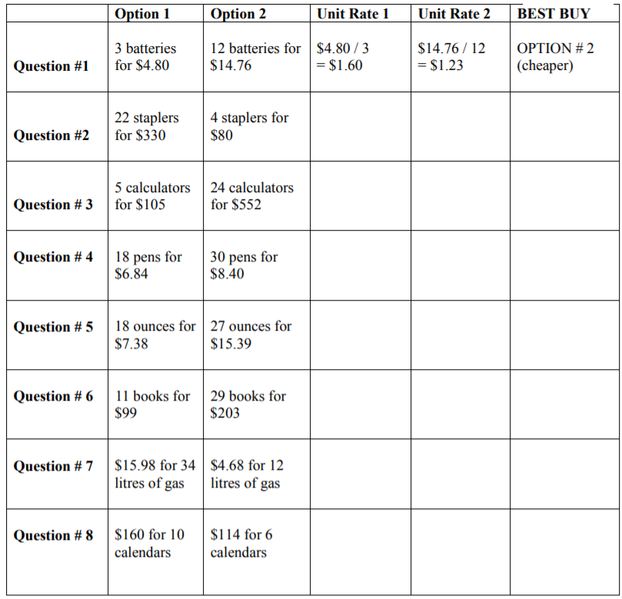






Comparing prices per item
The calculation is always:
$1.60 per battery
$1.23 per battery
Option 2 is cheaper
$$cost÷quantity$$
$$\$4.80÷3 batteries$$
$=\$1.60$ per battery
$$\$14.76÷12 batteries$$
$=\$1.$23 per battery
Practice:
Now you do the rest

Slide 10
Answers are on the following slide…

Slide 11





Comparing prices per item
$$cost÷quantity$$
$1.60 per battery
$1.23 per battery
Option 2 is cheaper
$$\$4.80÷3 batteries$$
$=\$1.60$ per battery
$16.50 per stapler
$20 per stapler
Option 1 is cheaper
$$\$14.76÷12 batteries$$
$23 per calculator
Option 1 is cheaper
$21 per calculator
$=\$1.$23 per battery
$0.38 per pen
$0.28 per pen
Option 2 is cheaper
$0.41 per ounce
$0.57 per ounce
Option 1 is cheaper
$9 per book
$7 per book
Option 2 is cheaper
Option 2 is cheaper
$0.47 per litre
$0.39 per litre
$16 per calendar
$19 per calendar
Option 1 is cheaper

Slide 12
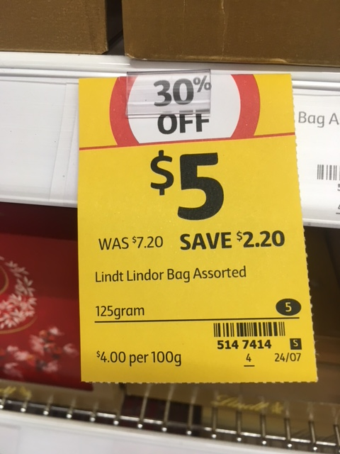
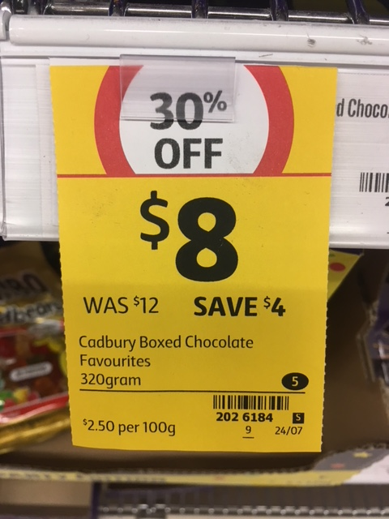













Comparing prices for the same quantity
Found in shops for value comparisons
This calculation always involves
It is usually given as $ per 100 grams
It is sometimes given as $ per 1 kilogram
$$cost÷quantity$$
‘per’ means ‘for every’
$$\$8÷320g$$
$=\$0.025$ per gram
$$\$5÷125g$$
$=\$0.04$ per gram
$$\$0.025×100$$
$=\$2.50$ per 100 grams
$$\$0.04×100$$
$=\$4$ per 100 grams
$$\$0.025×1000$$
$=\$25.00$ per 1 kilogram
$$\$0.04×1000$$
$=\$40.00$ per 1 kilogram

Slide 13
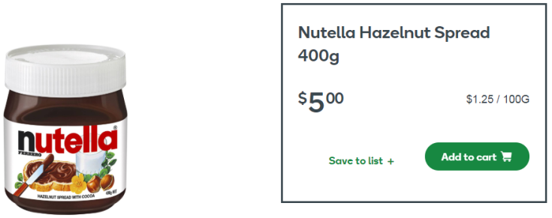
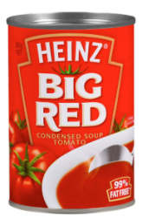
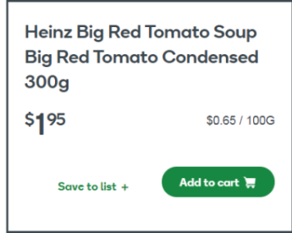
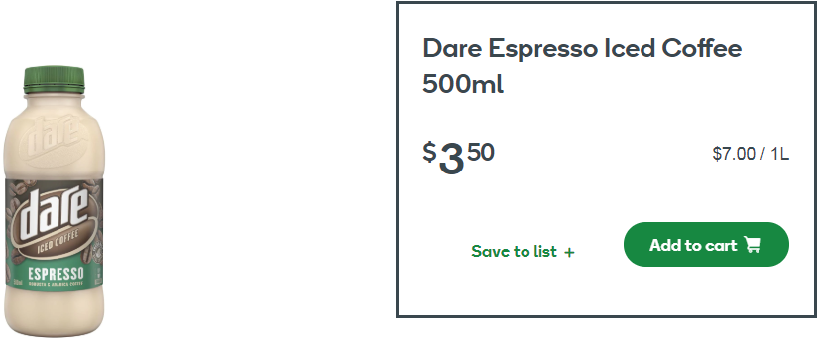
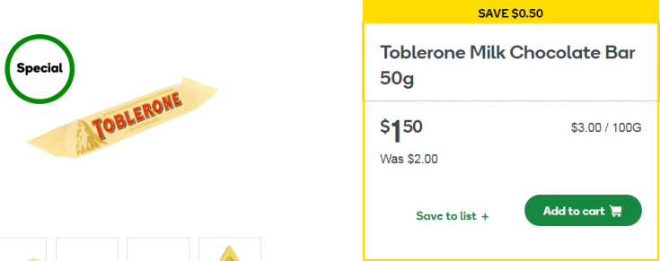







Calculate prices for the same quantity
Practice:
$$cost÷quantity$$
The first is done for you:
Item | Cost per gram | Cost per 100g | Cost per kilogram
$$\$5÷400g$$
$$\$0.0125×100$$
$$\$0.0125×1000$$
$=\$0.0125$ per gram
$=\$1.25$ per 100g
$=\$12.50$ per 1 kg

Slide 14
Answers are on the following slide…

Slide 15


















Calculate prices for the same quantity
Practice:
$$cost÷quantity$$
The first is done for you:
Item | Cost per gram | Cost per 100g | Cost per kilogram
$$\$5÷400g$$
$$\$0.0125×100$$
$$\$0.0125×1000$$
$=\$0.0125$ per gram
$=\$1.25$ per 100g
$=\$12.50$ per 1 kg
$$\$1.95÷300g$$
$$\$0.0065×100$$
$$\$0.0065×1000$$
$=\$0.0065$ per gram
$=\$0.65$ per 100g
$=\$6.50$ per 1 kg
$$\$3.50÷500g$$
$$\$0.007×100$$
$$\$0.007×1000$$
$=\$0.007$ per mL
$=\$0.70$ per 100mL
$=\$7.00$ per 1 L
$$\$1.50÷50g$$
$$\$0.03×100$$
$$\$0.03×1000$$
$=\$0.03$ per gram
$=\$3.00$ per 100g
$=\$30.00$ per 1 kg

